Slide 1

Python Material
Roshan Rajendra
Analyst
Aakaash Ramnath
Consultant
Get started with Python
(Friday) 22 – May – 2020

Slide 2
Journey
Why we started this initiative?
What was the challenge?
Entry-level or Fresh grads : India team On-boarded about 25 resources in the past 9 months
Onboarding Process Involved
Project Handholding
Upgrade Data Engineering skills
These challenges involved lot of personal time(In addition to the daily project work) and repetitive tasks as and when people were onboarded. The team collectively looked for a permanent solution to remediate this.
Long term Solution
Involve multiple team members to gather scattered content (Python, SQL and few other areas)
Review and Organize the material into a reusable format with sample data, examples and self learning instructions
Opportunity to gain confidence through presentations of material, open discussions
Teach the value of presentations and documentation to help the team grow organically

Slide 3
Existing features
What do we have as part of the material currently?
Interactive & Structured : Jupyter Notebook
Python 3.x
Learning-python3 notebook – Basic features and functionalities of Python,
Python objects, basic types, and variables
Python built-in functions and callable
Python object attributes (methods and properties)
Formatting strings and using placeholders
List, set, and dict comprehensions
Extensions notebook – Predominantly used Python libraries
Pandas - Data frame handling/flat files handling
Numpy - Playing with numbers
Azure Blob connectivity - File transfer interactions with Azure Blob
SFTP & FTP - Transfer files through FTP/SFTP locations
Matplotlib - Reporting/plotting charts and basic data exploration and analysis
pyodbc - SQL server connector to interact with the tables/views/other DB entities
Request - Make REST API calls like POST/GET/PUT/DELETE/PATCH/etc,..

Slide 4
Next steps
How do we proceed with this from here?
Short term – Through Team Collaboration
Add challenging problems and allow the team to self assess
To work on notebook navigation and make the content as primer to make it simple for beginner and experienced Data Engineers
To included more libraries and features of Python that covers extensive areas like Web scrapping and interaction, Spark, API Data pull.
Long term
Centralize this for anyone who would like to contribute and add in new topics/examples to help increase knowledge base. A Wiki of sorts, to evolve this into a Cervello’s Curative Python material with the help of the entire team and not just few players.
Keep up with the market trends and share good practice coding standards.

Slide 5

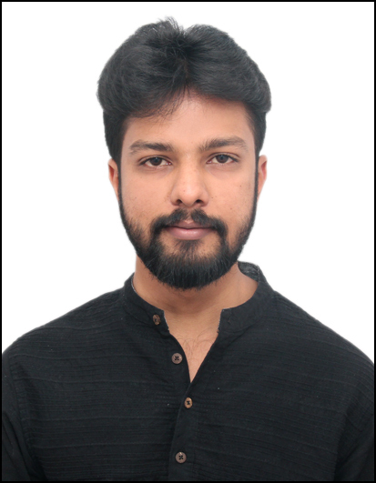

Active contributors
Roshan Rajendra
Tushar Porwal
Lokeshkumar Gunasekar

Slide 6
Q and A

